Slide 1


Identification of genomic
variants using the SILE Method
Extension of the Research module &
Focus on the Brugada Syndrome

Slide 2
Introduction
01
Objectives
Genomics
Brugada Syndrome
SILE Method
CONTENTS
Methods
02
SILE to
Brugada Syndrome
Extension of Research module
Validation of the Solution
03
BRGDA & BRGDA1
Other Genes
Discussion
Conclusions
04
Conclusions
Future Works

Slide 3
01
Introduction

Slide 4
INTRODUCTION
I) Objectives
Evaluation of SILE Method applied to Brugada Syndrome
Improvement of the Research module of SILE
Evaluation of the Improvement
II) SILE Method
S: Search
I: Identification
L: Load
E: Exploitation
III) Brugada Syndrome
Diagnosis
Treatment
IV) Genomics Concepts
DNA
Chromosomes
Genes
Variations
Genotype
Phenotype

Slide 5
S
Research and selection of genomic data sets to have quality data
Genomics data are scattered in many data sources
Each of them containing different information about different genes and variants
Goal: collect as many relevant data as possible
There is no protocol / method for searching and identifing relevant information
SILE method to integrate all the relevant information in the same place
I
Filter information gathered
Discart non-relevant and duplicates
Keep only variations that have sufficiently relevant evidence
Manually solve inconsistencies
L
Platform based on the CSHG (Conceptual Schema of the Human Genome)
Validation carried out by the platform
E
Extract knowledge from the information stored
Platform to visualize data
Comparison between genetic variations

Slide 6
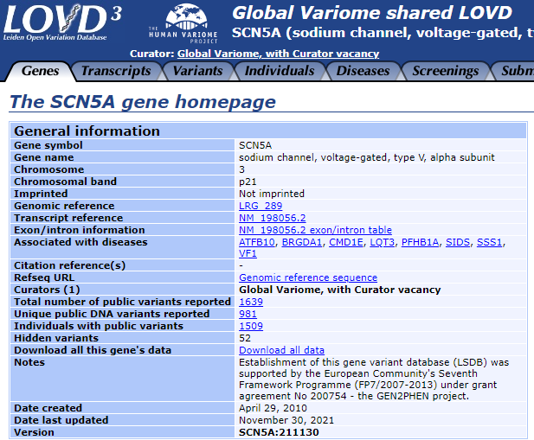
LOVD (Leiden Open Variation Database)
Open source database containing information about genomic variations
More than 23,000 different genes
Follows the reccomendations of HGVS (Human Genome Variation Society)
6 categories:
Genes
Transcripts
Variants
Individuals
Diseases
Screenings

Slide 7
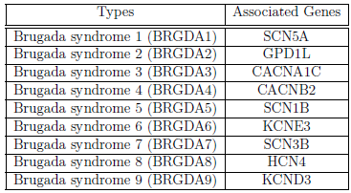
BRUGADA
DIAGNOSIS
Rare cardiac arrhythmia
If left untreated can cause fainting, difficult breathing and high risk of sudden cardiac death, usually when sleeping
Can be caused by mutation in one gene:
TREATMENT
Symptomatic:
Implantation of Implantambel Cardioverterer-defibrillator
(only treatment effective)
Asymptomatic:
Individual risk assesment
Consider other risk factors (age, sex, external)
Globally affect 0,5 per 1000
In Southeast Asia 3,7 per 1000

Slide 8

GENOMICS CONCEPTS
HUMAN GENOME:
DNA and RNA
CHROMOSOMES
PHENOTYPE
GENES
GENOTYPE
VARIATIONS

Slide 9
02
Methods

Slide 10
METHODS
1) Application of SILE method to
BRUGADA Syndrome
2) Extension of Research module

Slide 11
SILE TO BRUGADA
Analyze Data
Check Data
10 phenotypes
236 variations
179: BRGDA (75%)
41: BRGDA1 (17%)
Both mainly related to SCN5A
Manually fix data inconsistencies:
Assembly
Variant name
Allele
SEARCH
LOAD
S
I
L
E
IDENTIFICATION
EXPLOITATION
Get data
Upload data
GWAS
Ensembl
ClinVar
Convert database in CSV format
Upload it to Delfos platform

Slide 12
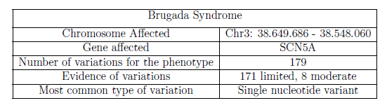
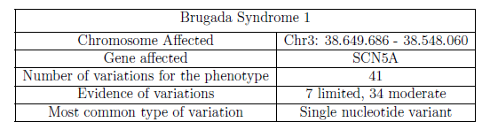
SILE TO BRUGADA
1 variation for BRGDA2, BRGDA7, BRGDA8, BRGDA9
2 variations for BRGDA3, BRGDA5
7 variations for "Brugada Syndrome (Shorter-than-normal QT interval)"
1 variation for "Spontaneous Brugada pattern ECG"

Slide 13
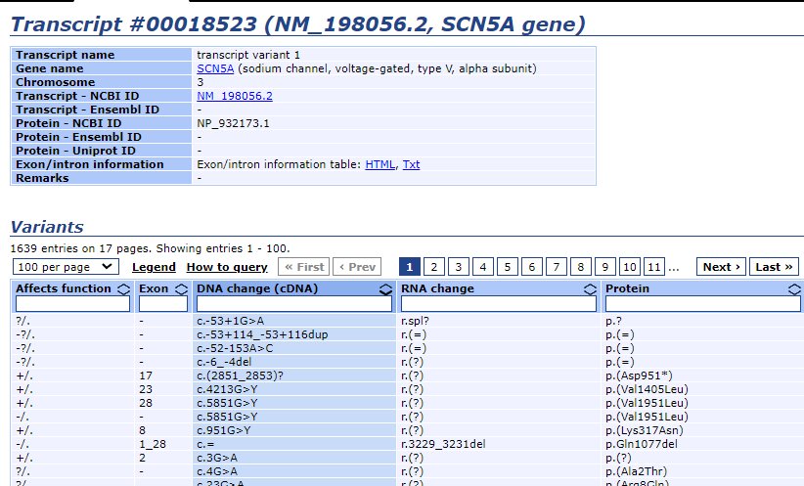
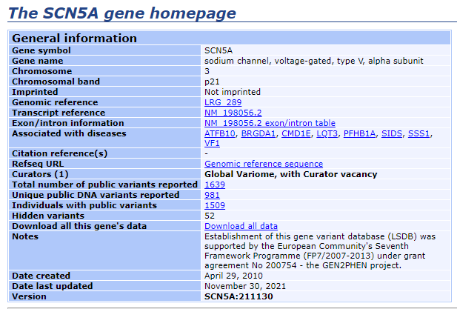
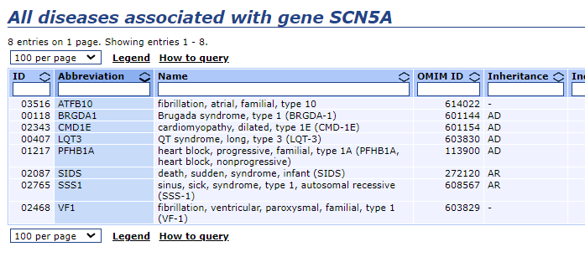
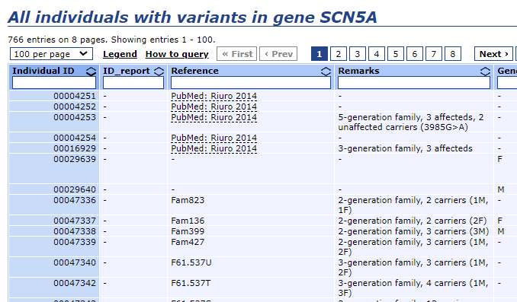
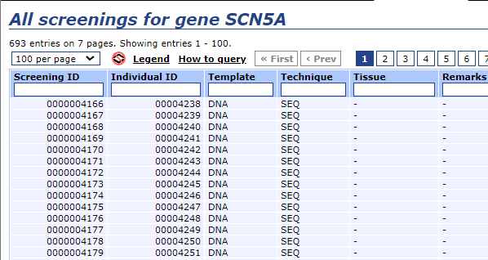
EXTENSION
SILE
Rselenium library used for:
Transcripts, Individuals, Screenings

Slide 14
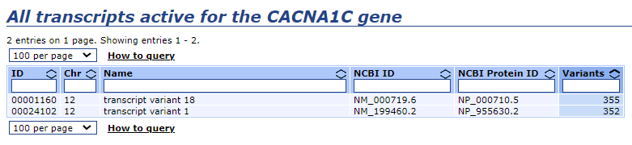
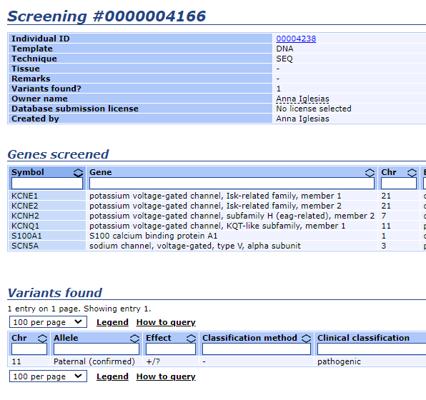
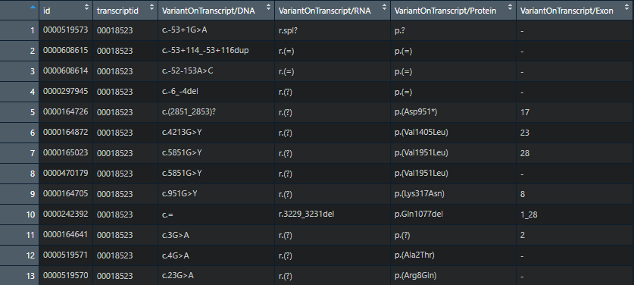
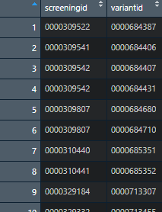
EXTENSION
SILE
VARIANTS ON TRANSCRIPTS
SCREENINGS TO VARIANTS

Slide 15
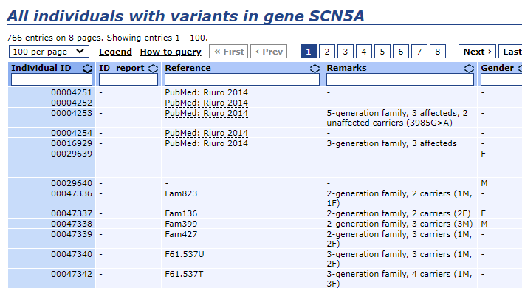
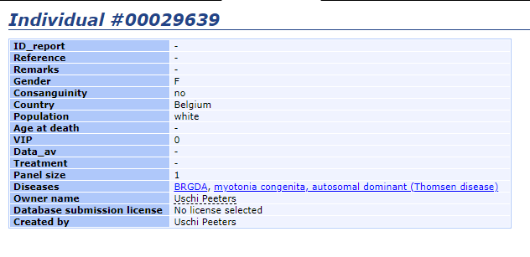
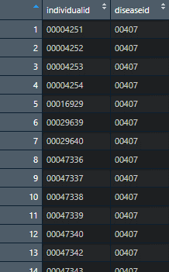
EXTENSION
SILE
INDIVIDUALS TO DISEASES
Starts from Individuals page
Delete all the rows without ‘‘disease’’
Make a list taking only ‘‘Individuals ID’’ column
Goes en each Individual page
Takes Disease ID from each ‘‘href’’ and associate it with the individuals list

Slide 16
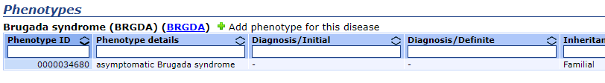
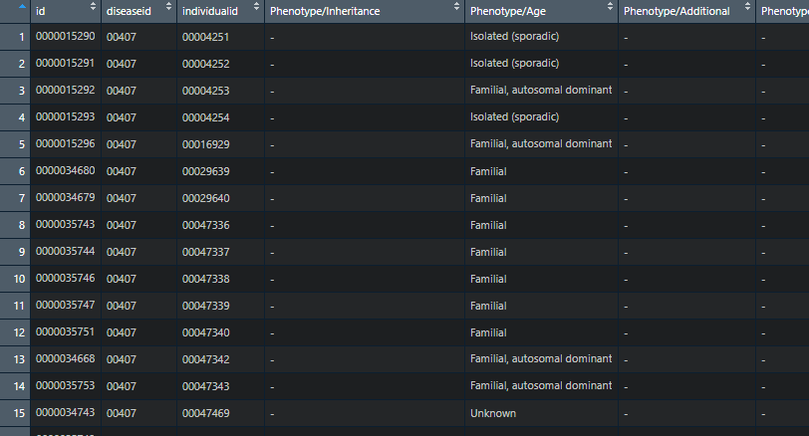
EXTENSION
SILE
PHENOTYPE
Start from the Individual ID list obtained before
Goes in each Individual page and takes data from Phenotypes table
Merges the obtained db with ‘‘individual to disease’’

Slide 17
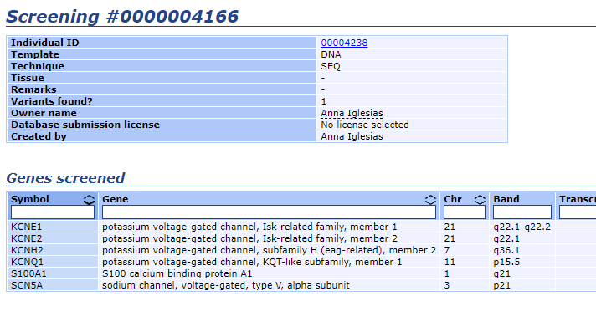
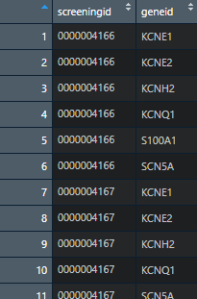
EXTENSION
SILE
SCREENINGS TO GENES
Start from the Screenings table
Goes in each Screening page and takes data from Genes Screened table
Keeps only Screening ID and Gene ID

Slide 18
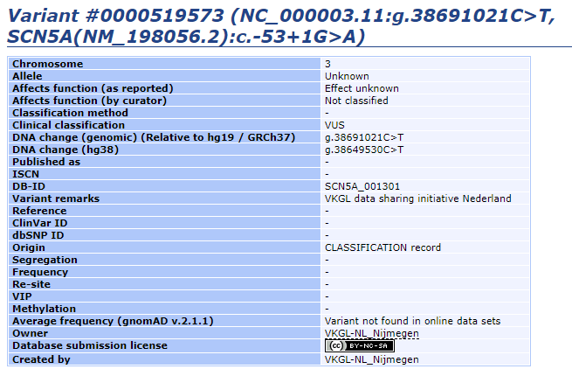
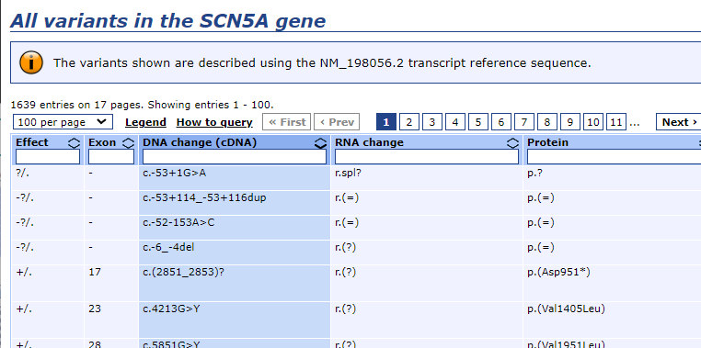
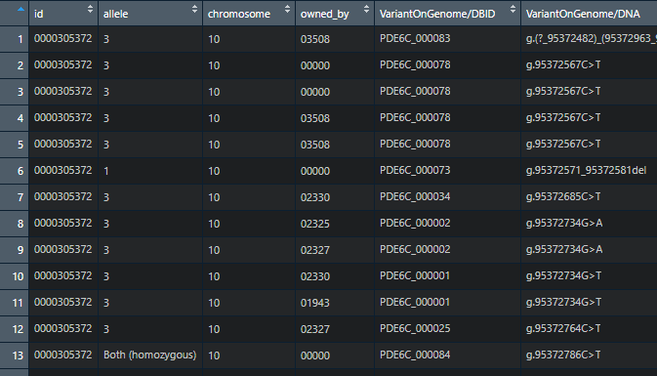
EXTENSION
SILE
VARIANTS ON GENOME
Takes the whole variants table and also put the href in each row in a separate list
Goes in each Variant page and takes data from the table
Merges the two tables

Slide 19
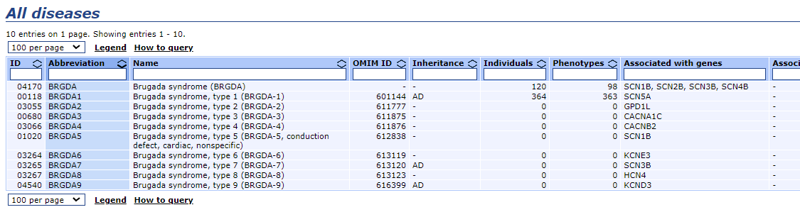
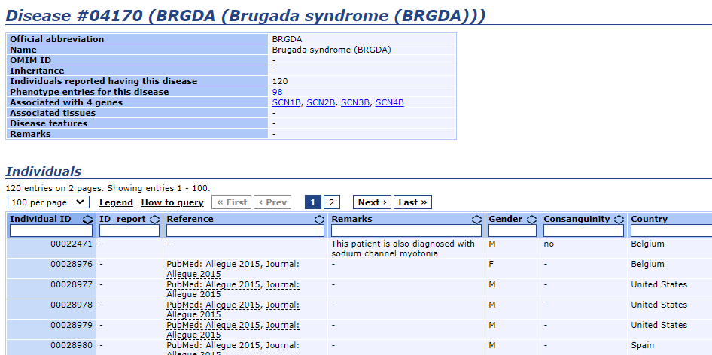
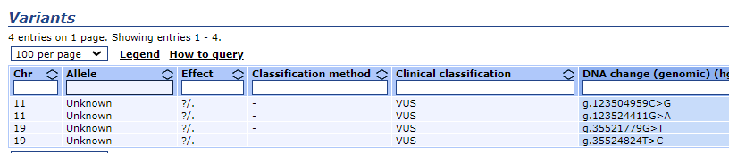
EXTENSION
SILE
RESEARCH BY PHENOTYPE
Starts from the Disease page related to the Disease choosen
Goes into each row and takes data from each individual table page
Goes into each Individual page and takes data from variants table
Merges Individuals and Variants tables
BRGDA & BRGDA1

Slide 20
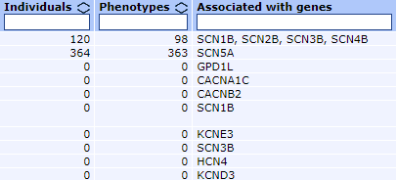
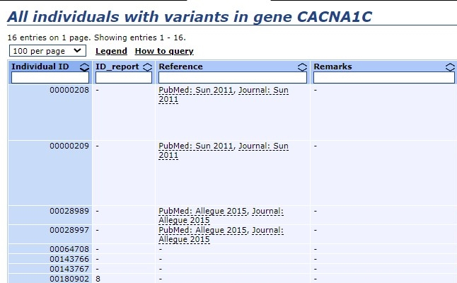
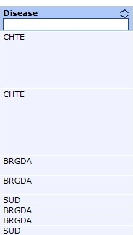
EXTENSION
SILE
RESEARCH BY PHENOTYPE
OTHER GENES
Takes the list of the Associated Genes from each row who has Individuals = 0
Goes in each Individuals page associated with each gene in the list
Goes into each Individual page and takes data from variants table
Merges Individuals and Variants tables
Filter the obtained table by the column ‘‘Disease’’ by taking only the related ones

Slide 21
Validation of the Solutions
03

Slide 22
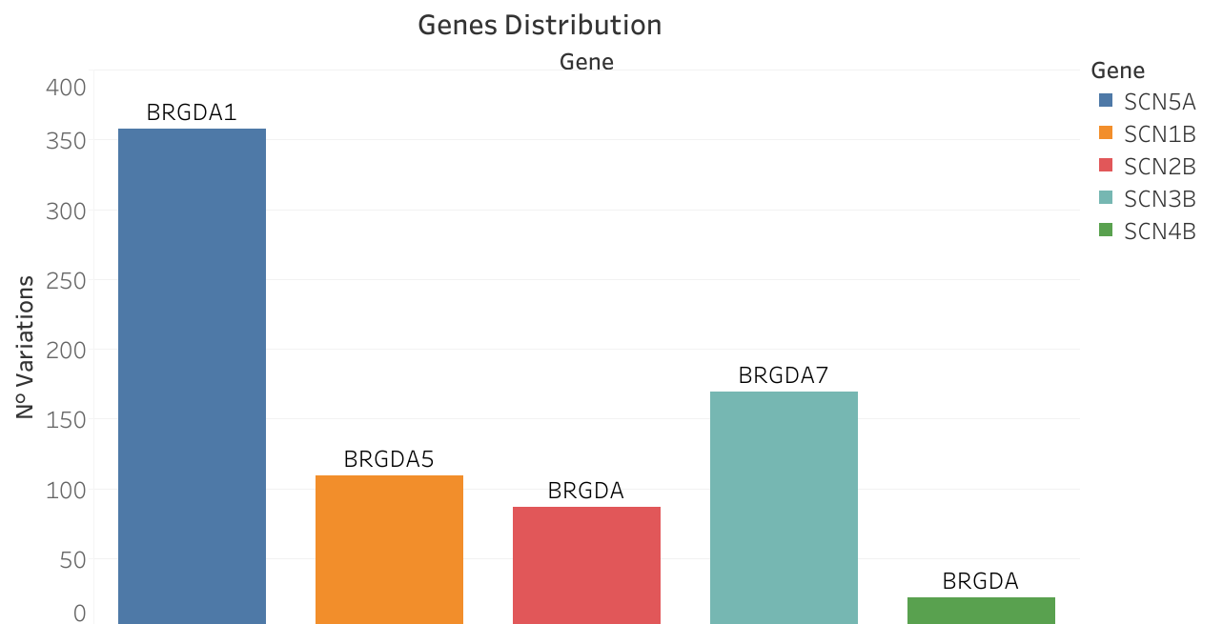
BRGDA & BRGDA1
Genes Distribution
BRGDA:
From 120 individuals, 420 variations data
Study of Peeters on 74 unrelated individuals
[SCN1B, SCN2B, SCN3B, SCN4B]
BRGDA 1:
From 364 individuals, 366 variations data

Slide 23
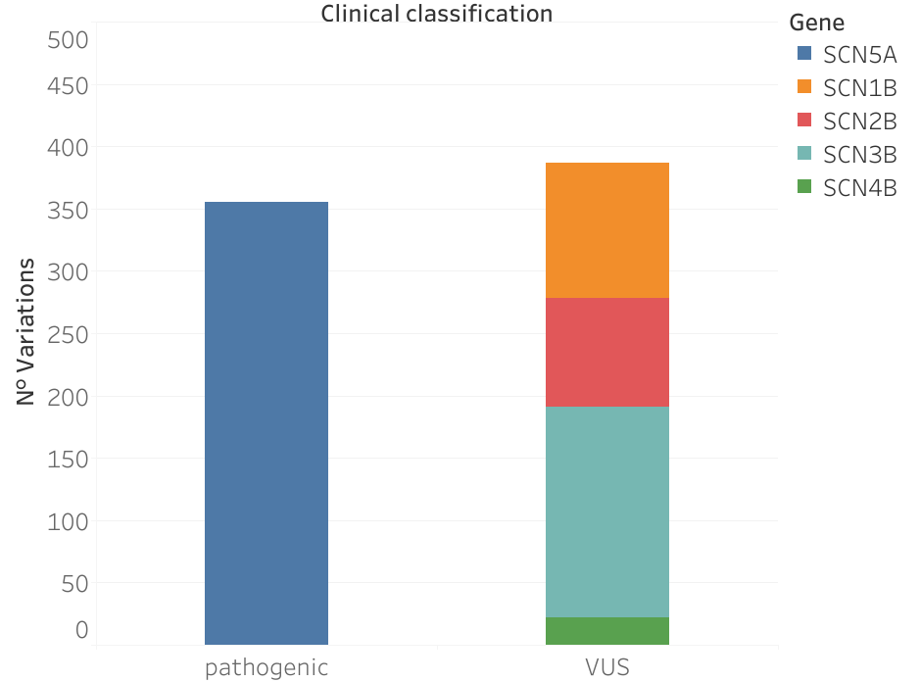
BRGDA & BRGDA1
Clinical Classification
BRGDA:
Totality of observations classified as
“VUS”
(Variant of Uncertain Significance)
BRGDA 1:
Totality of observations classified as “pathogenic”

Slide 24
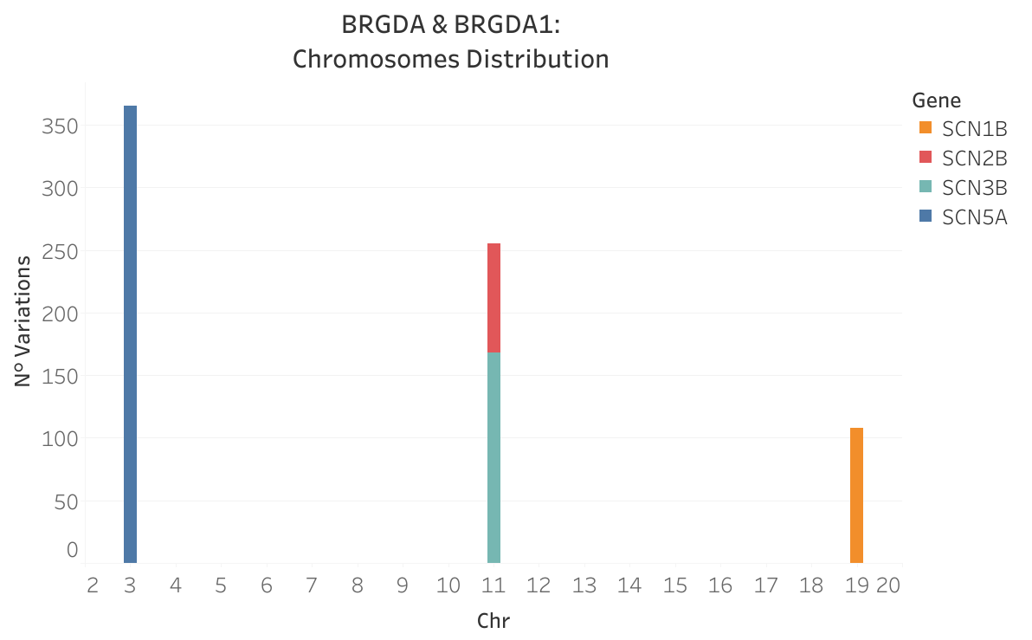
BRGDA & BRGDA1
Chromosomes Distribution
SCN5A, typically associated with BRGDA1, mutation in chromosome 3
SCN1B, typically associated with BRGDA5, mutations in chromosome 19
SCN3B, typically associated with BRGDA7, mutations in chromosome 11

Slide 25
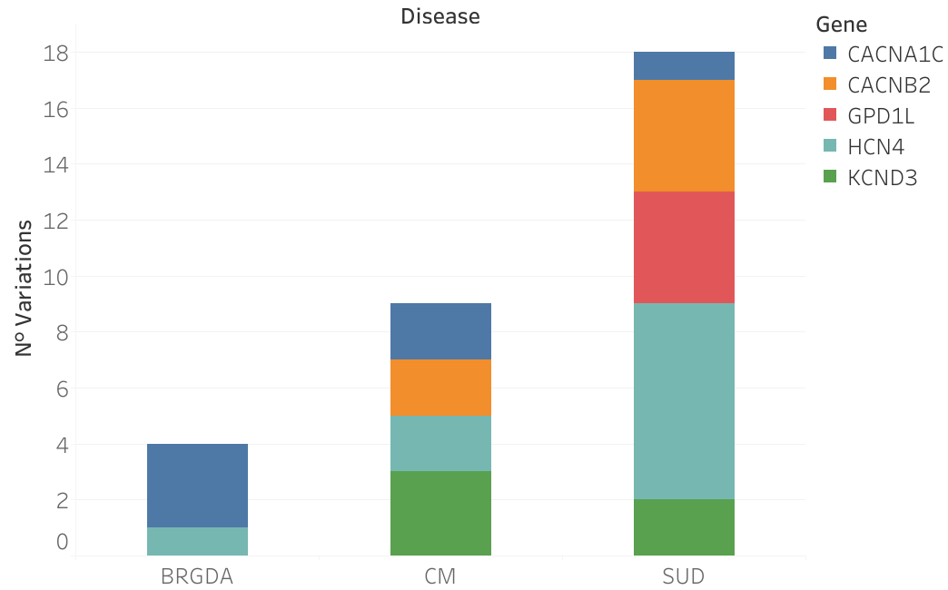
OTHER GENES
Diseases Distribution
From the 921 variations obtained:
Deleted the ones already present in the previous database by “individual ID”
Selecting the ones labeled as:
BRGDA
CM (Cardiomyopathy), associated with strong arrhythmias
SUD (Sudden Unexplained Death), synonym of Brugada in MedGen
Resulting db composed by 31 variations

Slide 26
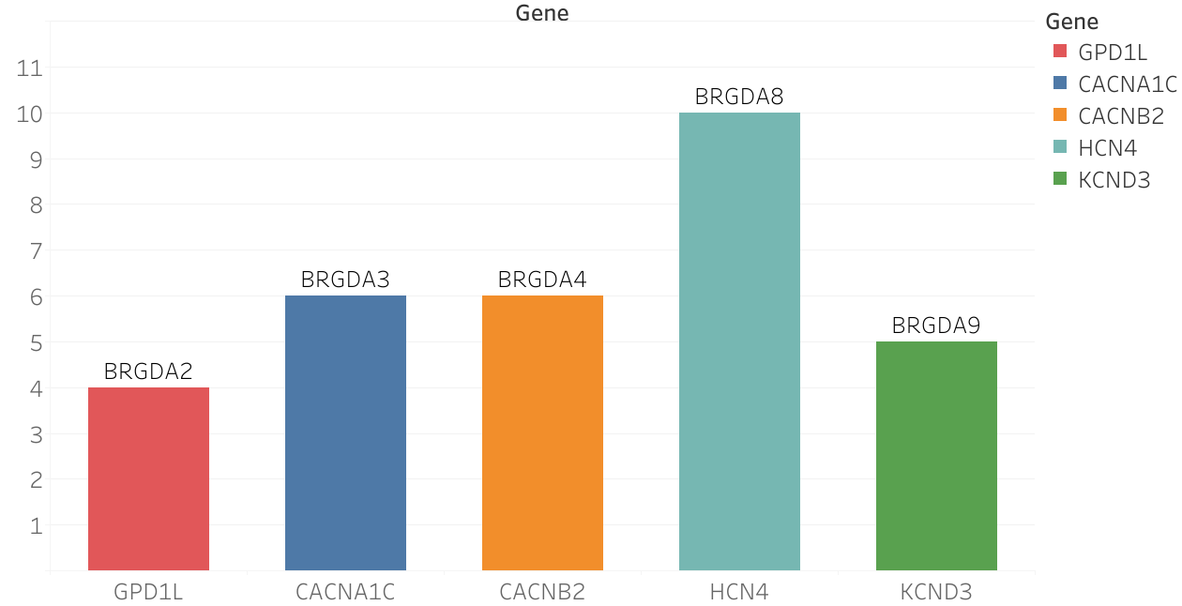
OTHER GENES
Genes Distribution
Variations in:
GPD1L (4)
CACNA1C (6)
CACNB (6)
HCN4 (10)
KCND3 (5)
Typically associated with:
BRGDA2
BRGDA3
BRGDA4
BRGDA8
BRGDA9

Slide 27
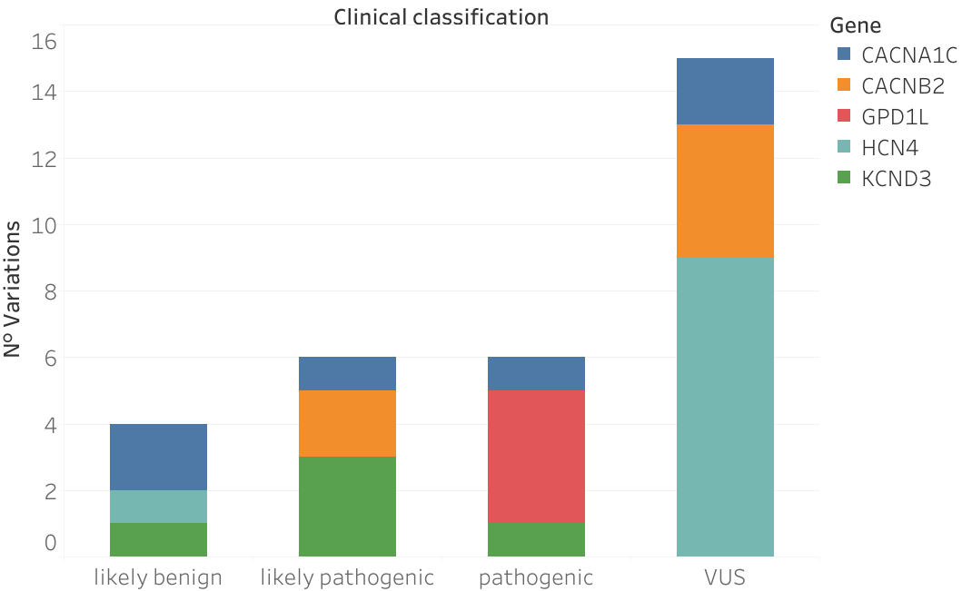
OTHER GENES
Clinical Classification
15 variations labeled as “VUS”
GPD1L labeled as “pathogenic” in all observations
KCND3 in the majority “likely pathogenic”

Slide 28
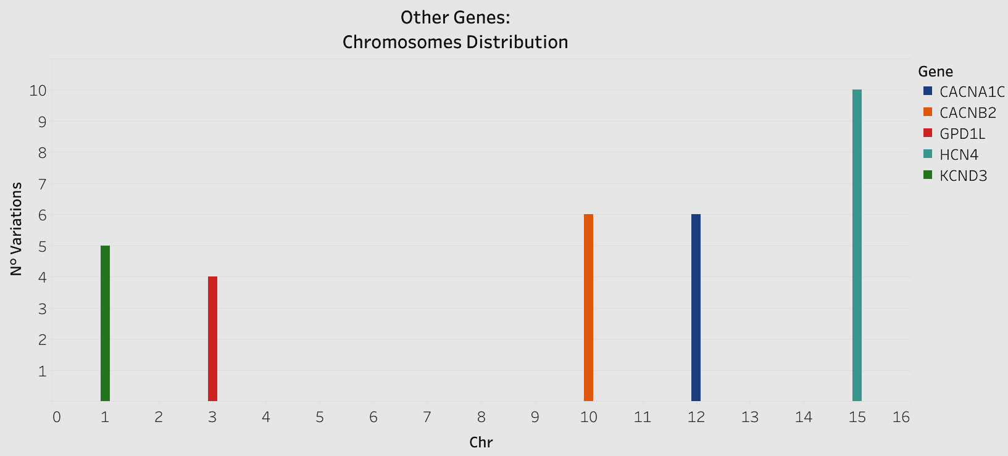
OTHER GENES
Chromosomes Distribution
GPD1L, mutation in chromosome 3 (Brs2)
CACNA1C, mutation in chromosome 12 (BrS3)
CACNB2, mutation in chromosome 1 (BrS4)
HCN4, mutation in chromosome 15 (Brs8)
KCND3, mutation in chromosome 1 (BrS9)

Slide 29

DISCUSSION
DOWNLOAD:
PRO:
Reduce time to collect data
CONS:
Feature available for only a small group of the genes in LOVD
Lower quality of data obtained:
Data in download file are updated manually, so most of the time the information present in it are different from the ones on the website
Can’t obtain the information present in “Research by Phenotype”, fundamental for the analysis carried out by PROS

Slide 30
DISCUSSION
Library “rvest” only obtains data in the first table (max 100), even manually changing the url the result doesn’t change
Usually variants, screenings and individuals have more than 100 entries
Library “Rselenium” overcomes the problem by simulating the navigation and clicking the button to take data from the subsequent tables
TIME:
Screenings page, even in normal navigation, takes more time than others to load
No API available, so web scraping is the only way to obtain data for the moment
Brugada Syndrome is a rare disease, the most common type is BRGDA1
Types from BRGDA2 to BRGDA9 are even more rare so only few data are available and in most of the cases are labeled with the generic name “BRGDA”
DATA:

Slide 31
04
Conclusions

Slide 32
CONCLUSIONS
OBJECTIVES:
1) After applying SILE method to Brugada Syndrome, noticed a reduced presence of data
2) For this reason, another source of data has been added to the ones already present: the biological database LOVD
3) Evaluated the effectiveness of the extension of the research module by applying it to analysis of Brugada Syndome

Slide 33
CONCLUSIONS
Most of the data obtained (45%) refers to the variations of SCN5A as “pathological”, which is associated with BRGDA1 (most widespread type)
BRGDA1:
Most of the data belonging to BRGDA has variations in genes SCN1B and SCN3B, generally associated to BRGDA5 and BRGDA7
Clinical classification labeled as “VUS” (not yet possible to determine if pathological or benign)
BRGDA:
Variations of GPD1L, CACNA1C, CACNB2, HCN4, KCND3, labeled in LOVD as "CM" and "SUD"
Data keeped because generally associated with BRGDA2, BRGDA3, BRGDA4, BRGDA8, BRGDA9
More accurate assesment in following steps and evaluation by panel of experts to take this decision and to evaluate the overall quality of acquired data
OTHERS:

Slide 34
FUTURE WORKS
Algorithm developed able to add biological data not only related to Brugada, that overcomes the limitations imposed by the database, allowing to search data starting from a selected phenotype
Platform in future will become more user friendly, in order to make it usable by professionals in field of Precision Medicine
Since biological data are scattered and heterogeneous, adding more data sources could help to perform a better analysis as the cost of more time for searching and standardizing data
Cyclical update in automated way of the data from the various data sources
Perform researches starting from a specific Gene
Follow further developments in the data currently available, especially VUS

